Slide 1
Slide 1: Title Slide
Final Year Project Presentation
AI SIGN LANGUAGE TRANSLATOR FOR ENGLISH AND LUGANDA
Presented by:
Supervisor: [Supervisor Name]
Department of ICT & Engineering
Uganda Institute of Information and Communications Technology (UICT)
Date: …………June 2026

Slide 2
FINAL YEAR PROJECT PRESENTATION

Slide 3
Problem Statement
Communication barriers between the deaf individuals who use sign language and hearing individuals who do not understand sign language limit effective interaction.

Slide 4
Main Objective
To develop an AI Sign Language Translator for English and Luganda that translates Uganda Sign Language gestures into text to improve communication between deaf and hearing individuals.
Specific Objectives
To study and collect data on existing sign language translation systems and technologies.
To design and develop a real –time AI-based sign language recognition system for English and Luganda.
To test and evaluate the performance and accuracy of the developed system.

Slide 5
Scope
Technical scope: What the system does (and does not do).
The system captures sign language gestures using a camera.
AI processes the gestures and translates them into text and speech.
The system focuses on a selected set of common sign language gestures.
Geographical scope: Where the study was conducted.
The study was conducted at the Uganda Institute of Information and Communications Technology(UICT),Uganda
Time scope: Duration of the project.
The project was carried out from January, 2026 to June, 2026 (6 months)
Financial scope: Estimated cost.

Slide 6
Literature Review
Existing technologies studied (at least three):
The existing technologies studied include Google AI Sign Language Detection (ASL), Kenyan Sign Language Translator and Ugandan Sign Language Glove Project.
    Technology A:
    Google AI Sign Language Detection (ASL). It uses machine learning and 2D hand tracking to detect ASL gestures and translate to English and Luganda. It requires a stable internet and high-end cameras are required by TensorFlow, MediaPipe, CNN models Works only for ASL (Google, 2022).
    Technology B:
    Kenyan Sign Language Translator (University of Nairobi). It converts Local KSL into English text for classroom settings. There is lack of NLP component and local language integration in Python OpenCV and CNN models small dataset (Mbugua, 2020).
    Technology C:
    Ugandan Sign Language Glove Project (Makerere University). It uses Hardware-based glove to flex sensors and recognize sign languages. Arduino, flex sensors, ML models, Expensive hardware and low accuracy for dynamic gestures are its limitations (Tendo, 2023).

Slide 7
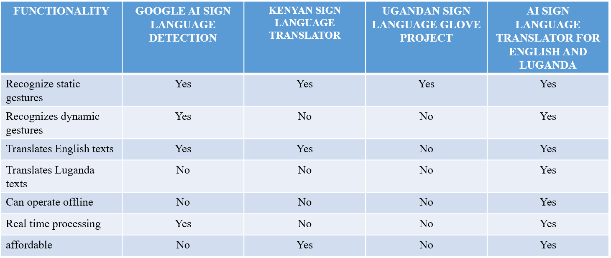
Comparative Evaluation

Slide 8
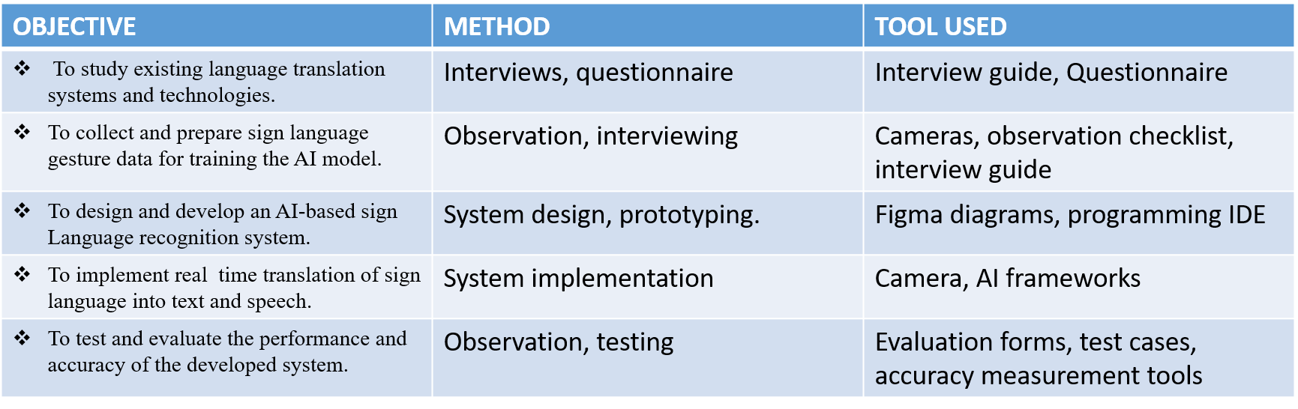
Methodology (How you achieved each objective)
For each specific objective, state the method and tool used:

Slide 9
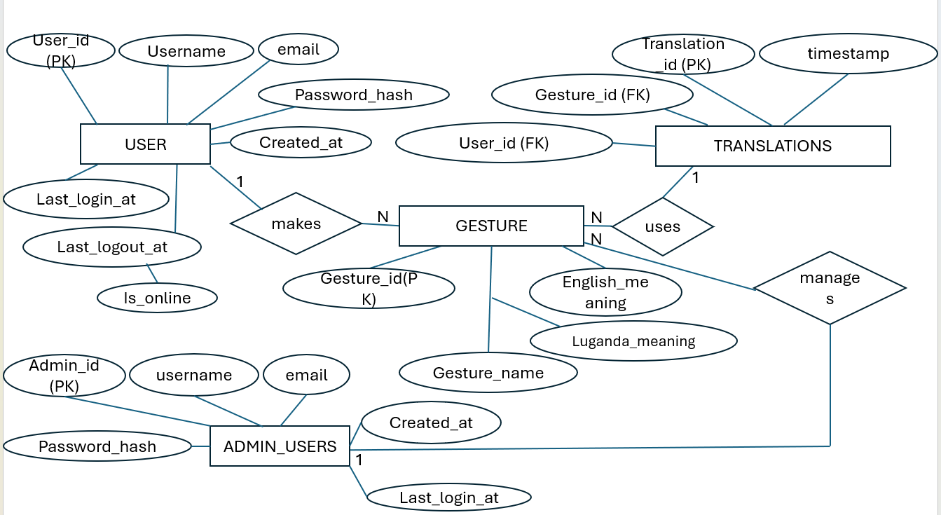
System Analysis
ERD

Slide 10
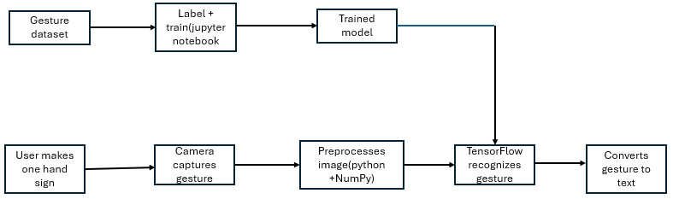
System Design
DataFlow Diagram

Slide 11
System Development
Take screenshots of the different parts (interfaces) of the developed system showcasing its functionality.
For each screenshot, briefly explain its purpose in relation to other diagrams under this objective.

Slide 12
System testing and validation
In each case, capture screenshots and give brief explanations of :
What was done
The website translates basic USL gestures.
why it was done
To bridge the communication gap between the deaf and the hearing individuals
The output received
The output received is accurate to 50% since more data has to be captured
Use different stakeholders to test the system
On the different stakeholders we involved various students

Slide 13
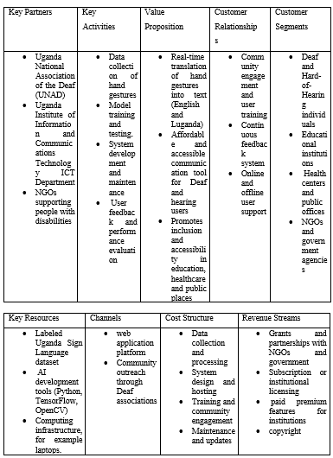
Business Model Canvas (Brief)

Slide 14
Challenges, Limitations & Recommendations
Challenges faced (technical, logistical, financial):
Technical challenges
The accuracy to be over 50% in gesture prediction.
Storage is a determining factor of the system since it needs too much data to gain a 90% prediction rate.
Limitations-weakness of the system
Confusing of gestures with the other captured ones
Recommendations to overcome them
A laptop with more storage capabilities and RAM can be purchased to advance and train the model perfectly.

Slide 15
Demonstration
This slide is a placeholder – you will Show your live prototype at this moment (no slide needed – just switch to your hardware).

Slide 16
Conclusion & Future Work
Conclusion:
Did you achieve the main objective?
Yes, the main objective of translating sign language gestures using the USL was achieved.
What did your project demonstrate?
Our project has demonstrated the inclusion of Artificial intelligence to solve problems affecting the academia community.
Future work:
What improvements could be made?
The communication capability whereby the deaf individual with the inability to speak can type text which is translated to audio.
What additional features could be added?
Text-to audio, lectures,
How can the project be commercialized or scaled?
The project can be commercialized or scaled through inclusion of a subscription packages where one accesses unlimited gesture translation capabilities.

Slide 17
Thank You / Q&A

